Slide 1
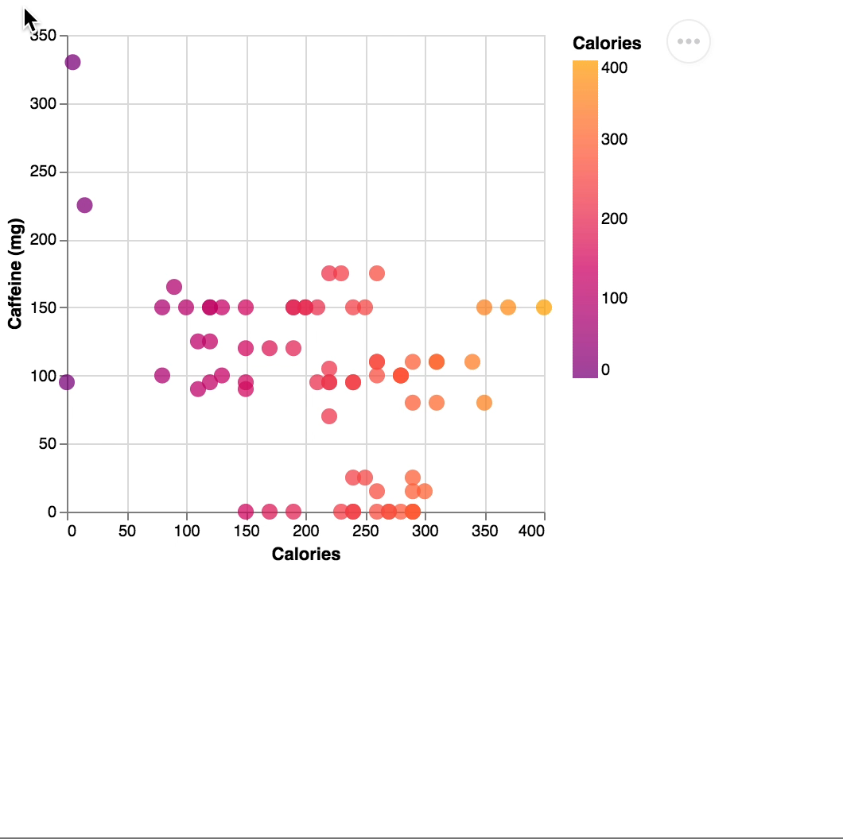
ResBaz Data Visualization Workshop
Agenda:
Data Vis basics & terminology
Web Charting with Vega-Lite
Free experimentation time
Template/Data for Code-Along:
https://bit.ly/ResBazVisWorkshop
Pre-Survey (Google Form):
https://tinyurl.com/VisWorkshopPreSurvey

Slide 2

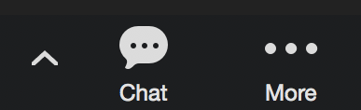

How we’re using Zoom
Declare you’re finished with activities with ”yes” notice in participant list.
When you have a question or answer, either:
Write it in the chat
Use the “raise hand” feature
Direct chat helper Alex Bigelow
Add to HackMD file:
https://hackmd.io/340RlLC1QnSwhRHC5_RAaw

Slide 3
Why Vega-Lite?
At Hackathons, I noticed most projects with visualization used basic charts and some projects had streaming data.
Vega-Lite is a lightweight, robust library when it comes to quickly creating basic charts from data.
Vega-Lite has support for streaming data (not covered in this workshop)

Slide 4
Other ResBaz Visualization Workshops!
Tuesday 1PM: Beautiful Plots with ggplot2 (R)
Wednesday 10AM: Shiny Dashboard in R
Wednesday 3PM: pandas and matplotlib in Python
Friday 3PM: Observable Notebooks (JS)
See also:
Friday 2PM: Intro to HTML/CSS

Slide 5
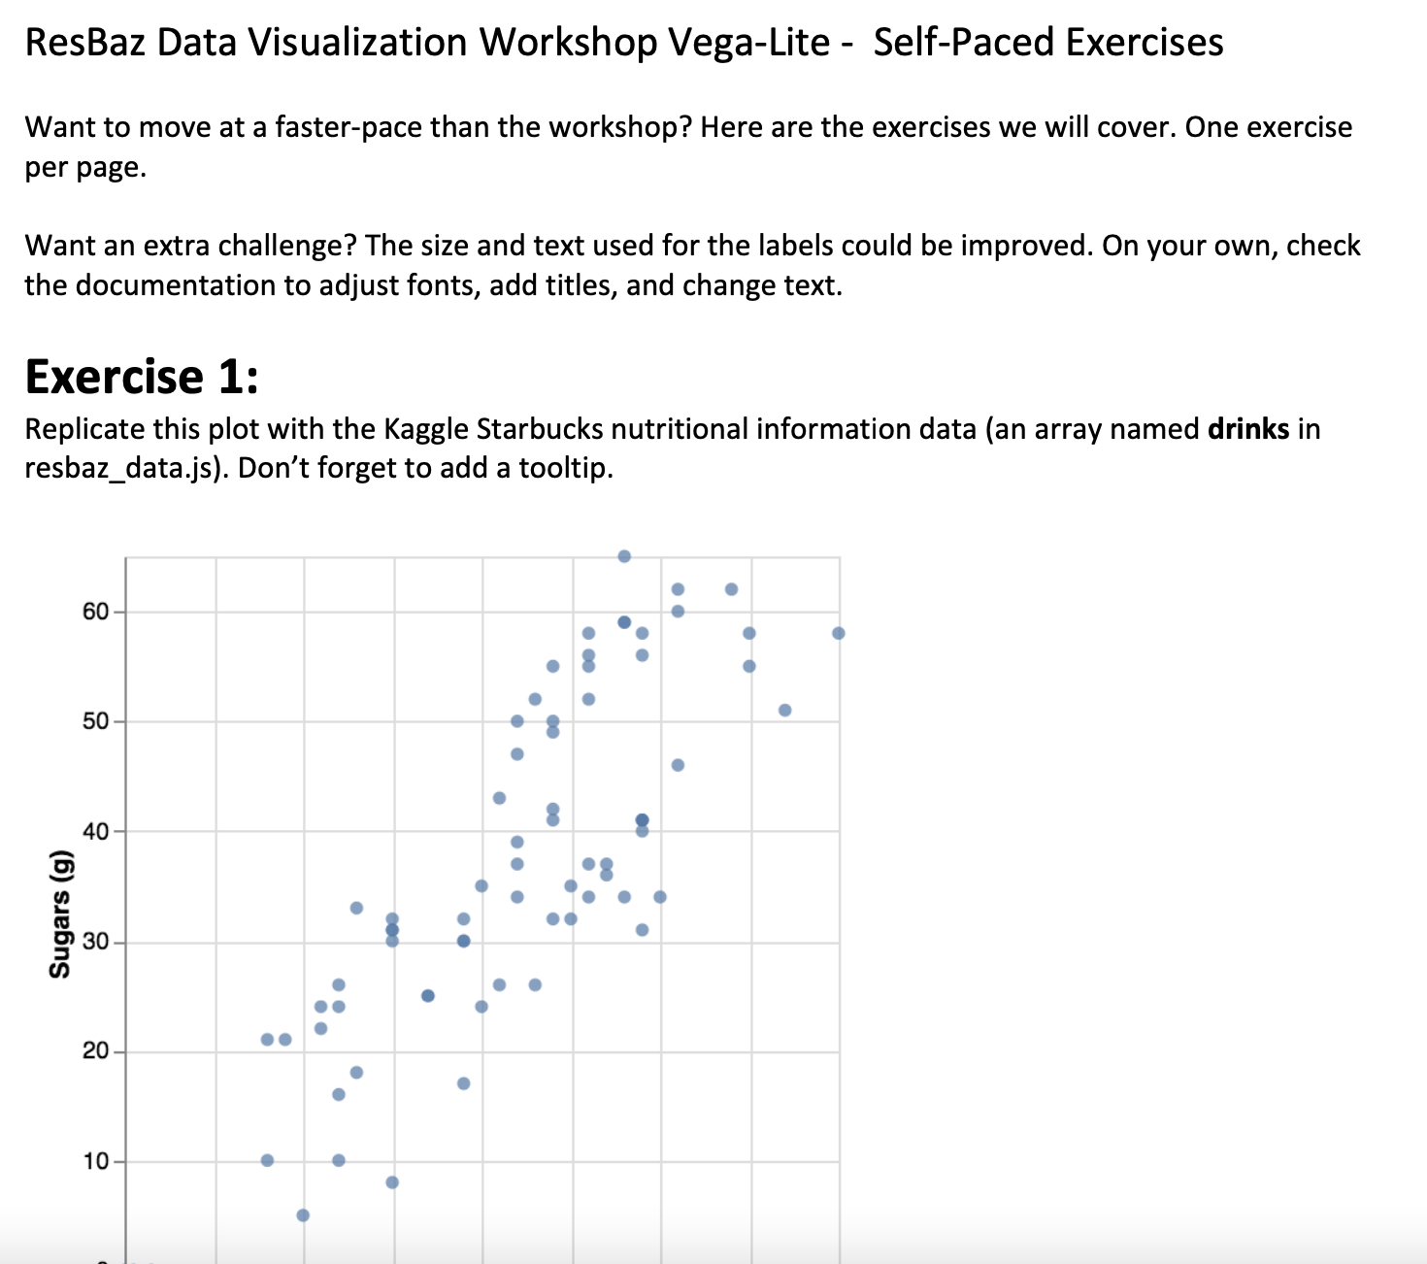
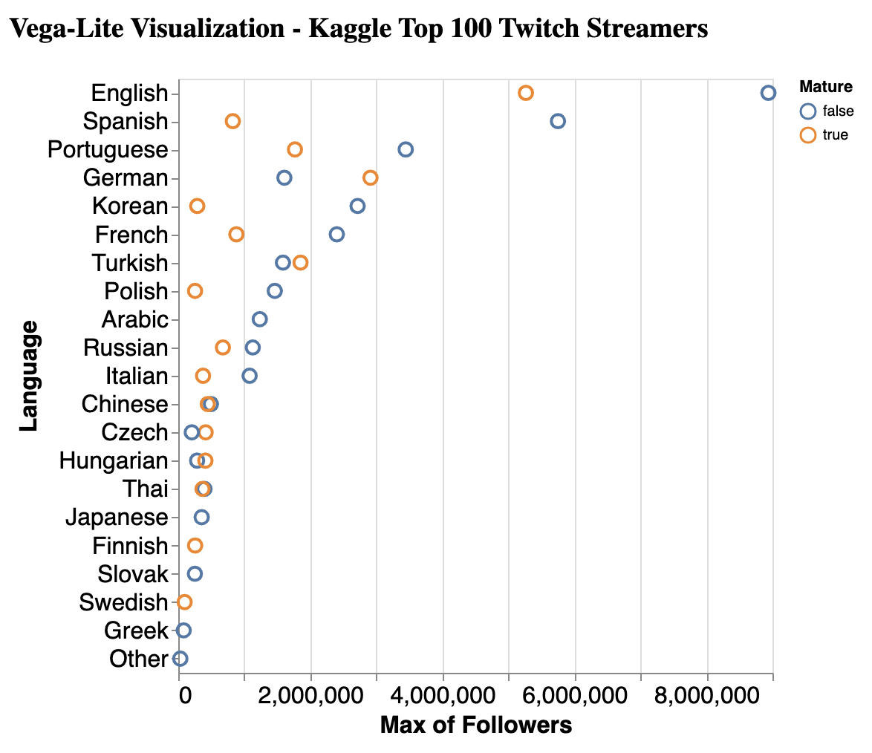
Do you want to go at your own pace?
Included is a PDF of the exercises & a Twitch dataset we won’t get to.

Slide 6
Some Data Terminology

Slide 7
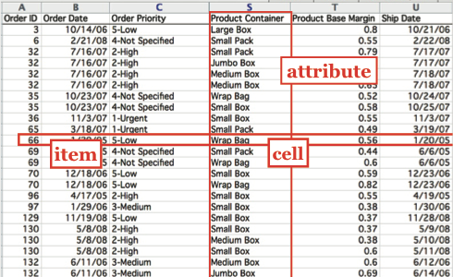
Data Tables
Each data point is an item (or records), usually represented as a row.
Columns contain values of a particular attribute (or field).
The value of an attribute for a particular item is a cell (or attribute value).

Slide 8
Types of Attributes
Quantitative data has order and allows mathematical operations
Ordinal data has order but not mathematical relationships
Nominal (a.k.a. Categorical) data has neither order nor mathematical relationships
Nominal
Images from Munzner, Visualization Analysis and Design
Notes:
Cyclic: Rock, Paper, Scissors

Slide 9
Examples
Nominal
Lengths
Counts
Pressure
Temperature
Weights
Distances
Dates
Coordinates
S, M, L sizes
Letter grades
Rankings
Likert scales (e.g., rate from very satisfied to very dissatisfied)
Shapes
Colors
Names
Blood types
Countries
Event types
Images from Munzner, Visualization Analysis and Design

Slide 10
What operations can you do?
Nominal
Compare:
=, ≠,<, >, +, -
Ratio Only:
×, ÷, ratios, proportions
Compare:
=, ≠,<, >
Compare:
=, ≠
Images from Munzner, Visualization Analysis and Design

Slide 11
Quantitative, Ordinal, or Nominal?

Slide 12
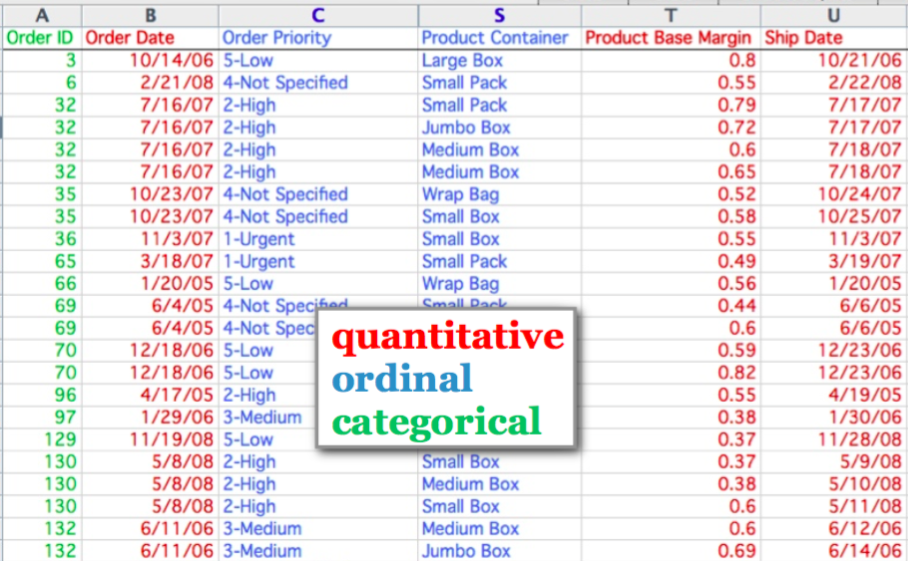
Quantitative, Ordinal, or Nominal?
temporal
nominal

Slide 13
Encoding: Mapping Data to Visualization

Slide 14
Marks, Channels, & Encoding
Encoding: Map data to visual structure
Marks: Graphical primitives that encode items / entities
Channels: Properties of mark appearance, often used to encode attributes or other information

Slide 15
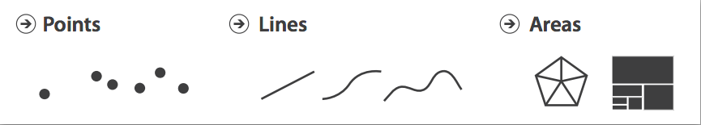
Marks: Graphical primitives that encode items or entities
Images from Munzner, Visualization Analysis and Design

Slide 16
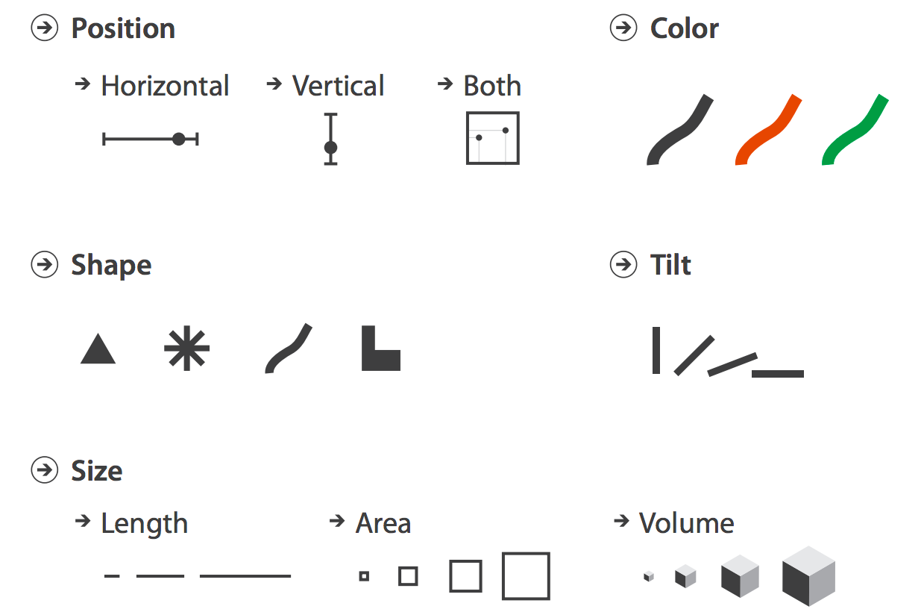
Channels: Properties of mark appearance, often used to encode attributes or other information
Images from Munzner, Visualization Analysis and Design

Slide 17
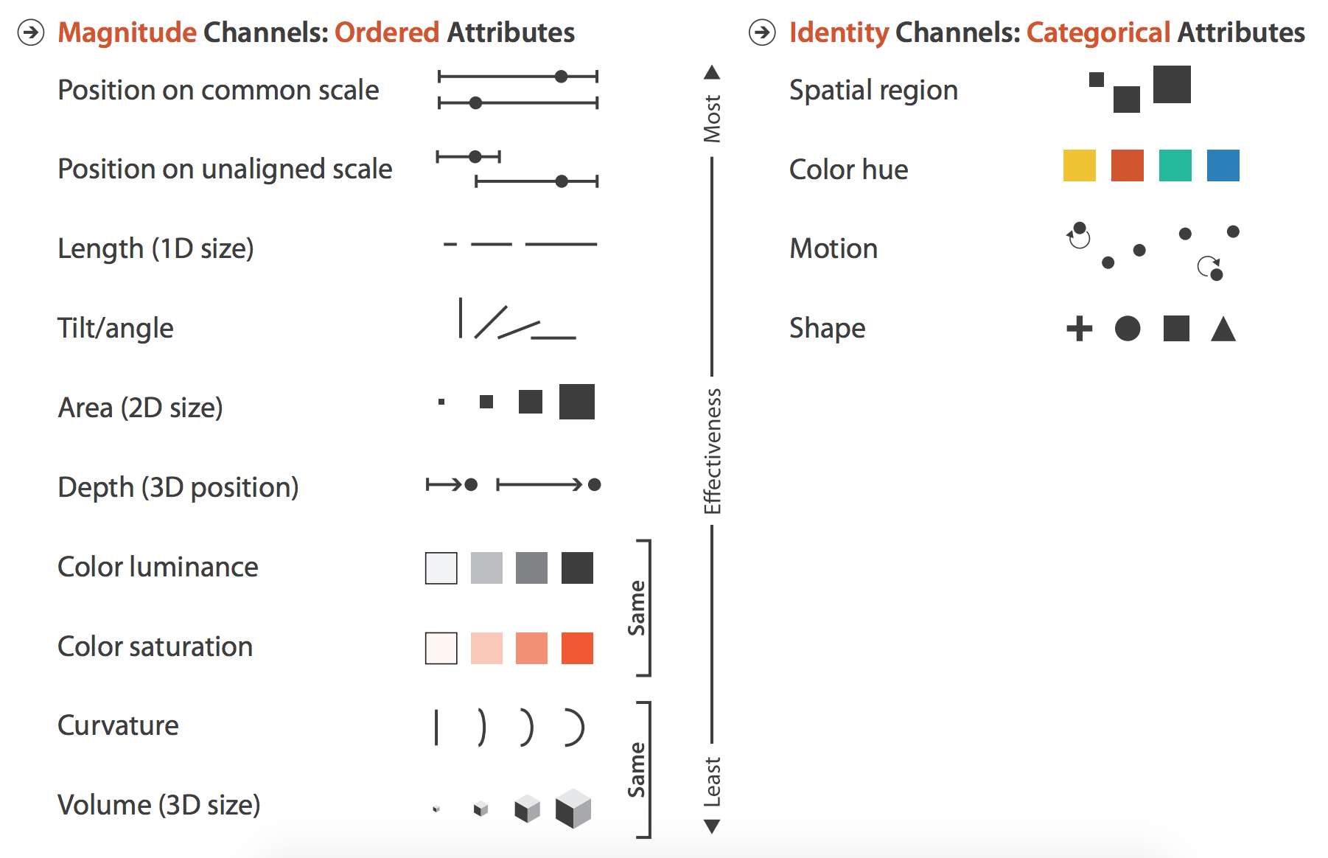
We can Construct a Mapping of Data Values to Perceptual Channels
Images from Munzner, Visual Analysis and Design

Slide 18
Encodings of Common Charts

Slide 19
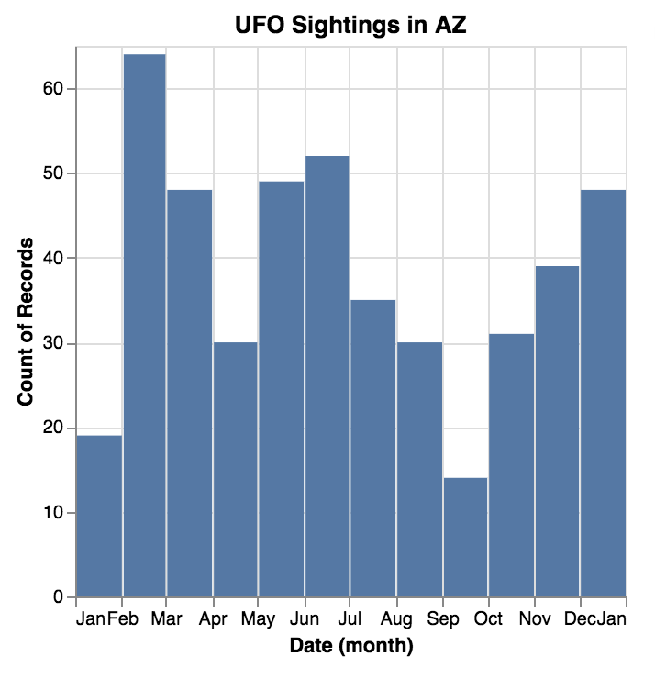
Bar Chart: Show relative counts
Marks: rectangles
Encoding: quantitative value is mapped to height of rectangle on a common scale
Quantitative (temporal) value is mapped to x-position

Slide 20
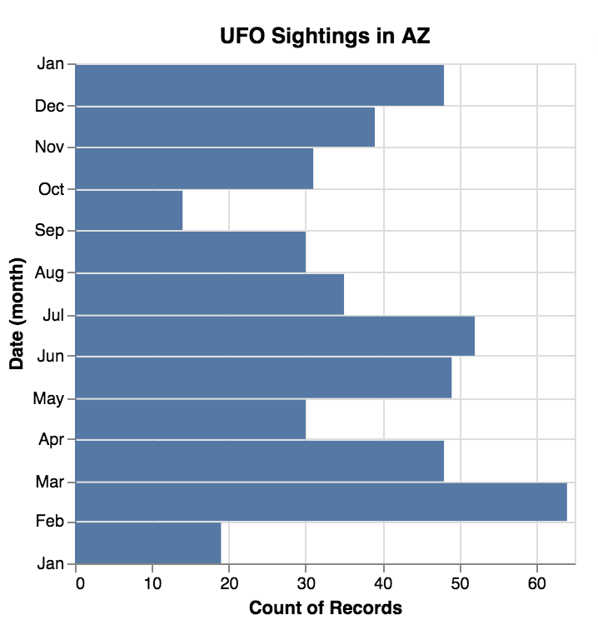
Consider rotating for text readability
Marks: rectangles
Encoding: quantitative value is mapped to width of rectangle on a common scale
Quantitative (temporal) value is mapped to y-position

Slide 21
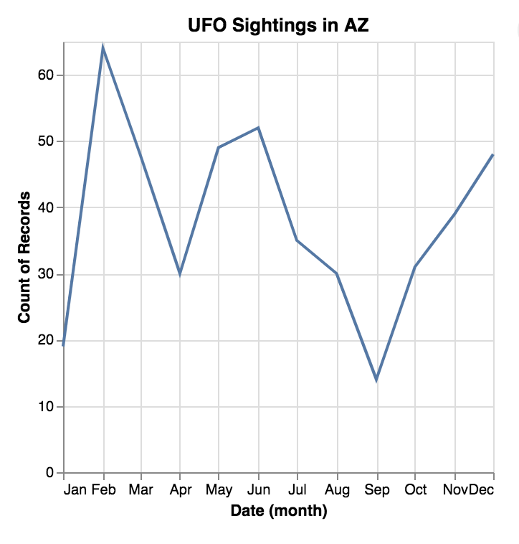
Line Charts: Show trends
Marks: lines
Encoding: quantitative value is mapped to y-position of line endpoint.
Temporal value is mapped to x-position

Slide 22
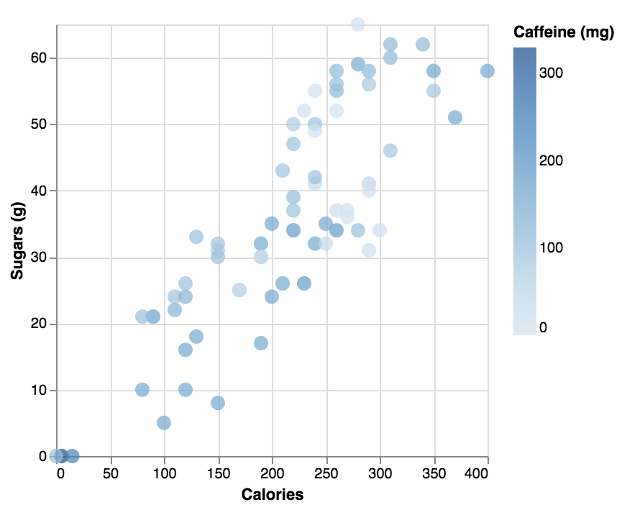
Scatter Plots: show correlation
Marks: points
Encoding: two quantitative values are mapped to x and y position respectively
In this example, one quantitative value is mapped to color.

Slide 23
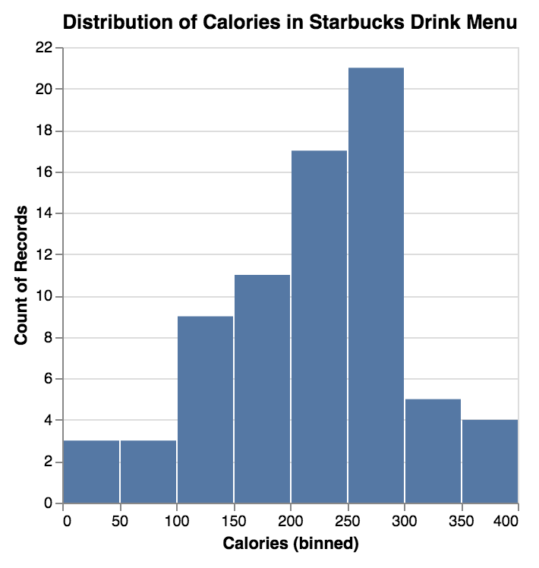
Histograms: show distribution
Marks: bars
Encoding: x position denotes range of calories, y position denotes number of drinks in that calorie range

Slide 24
Vega-Lite

Slide 25
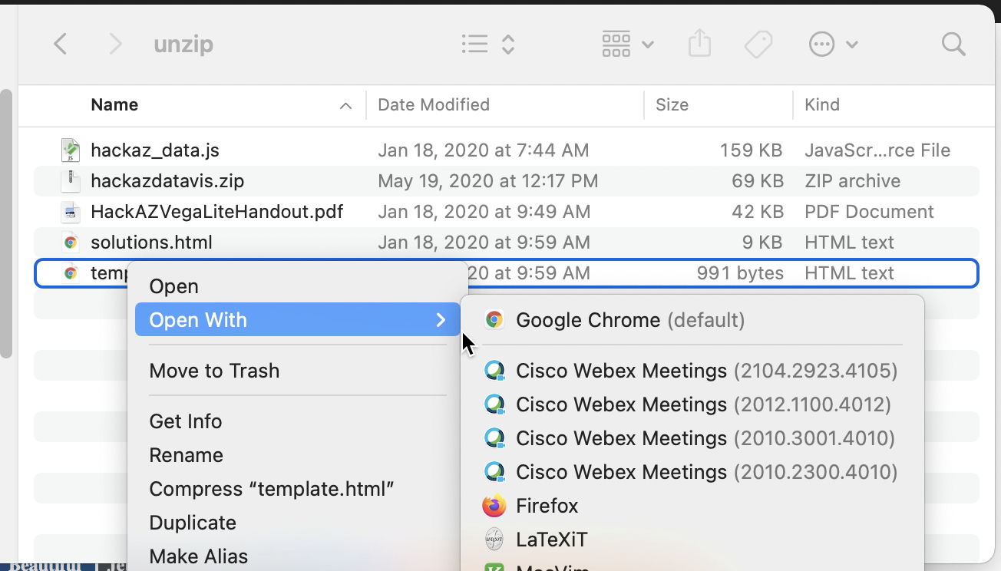
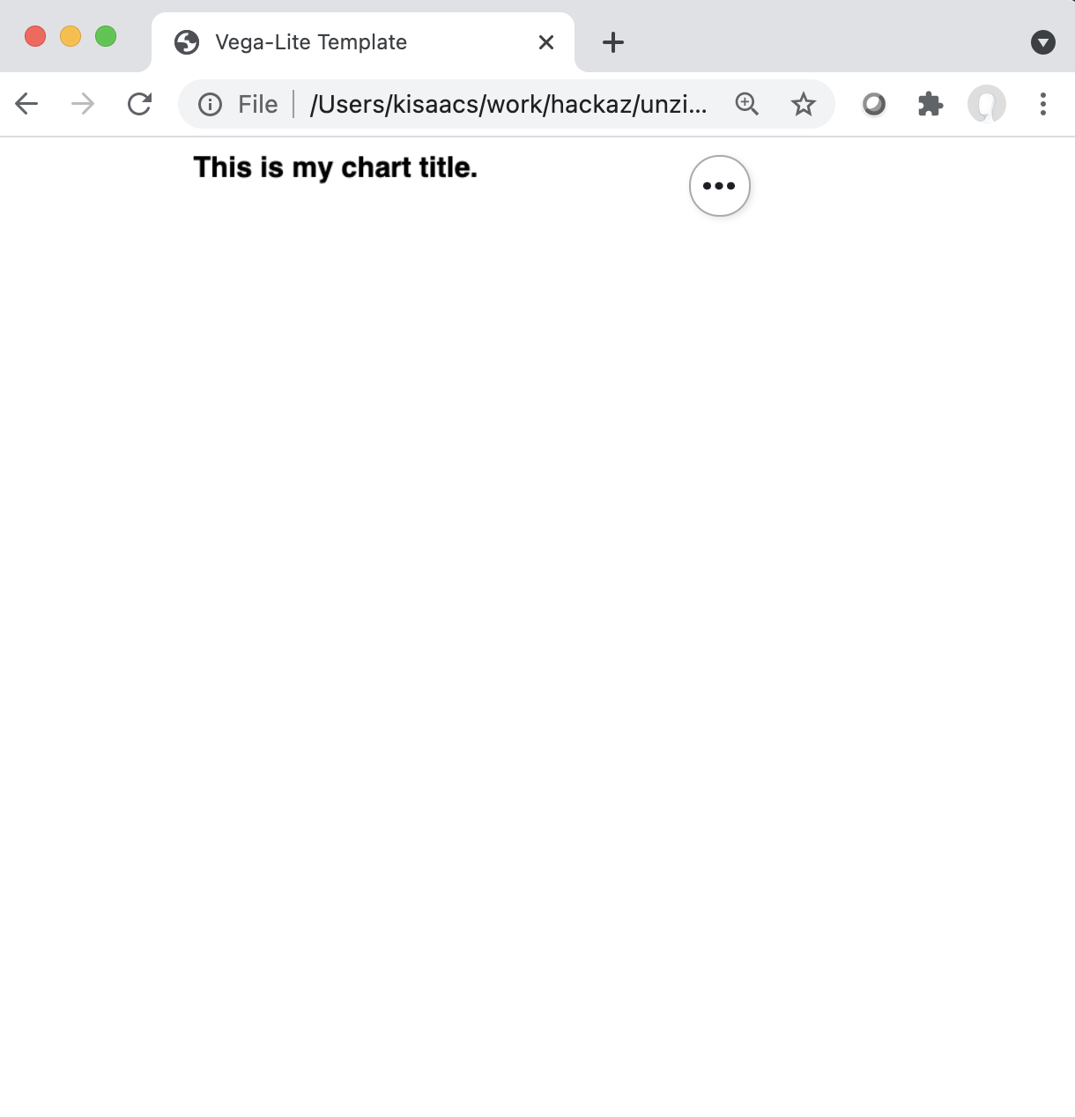
Let’s go through this together!
If you have not already, download the workshop files:
https://bit.ly/ResBazVisWorkshop
Unzip the file and open “template.html” in a web browser.
In most systems, you can open by double-clicking or right-clicking.

Slide 26
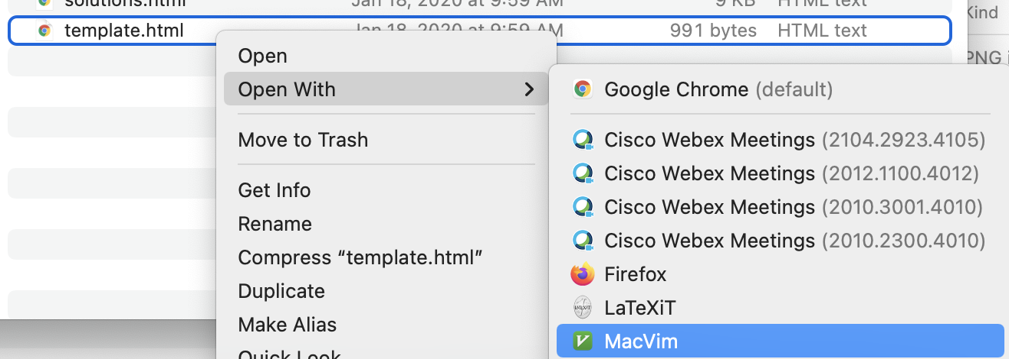
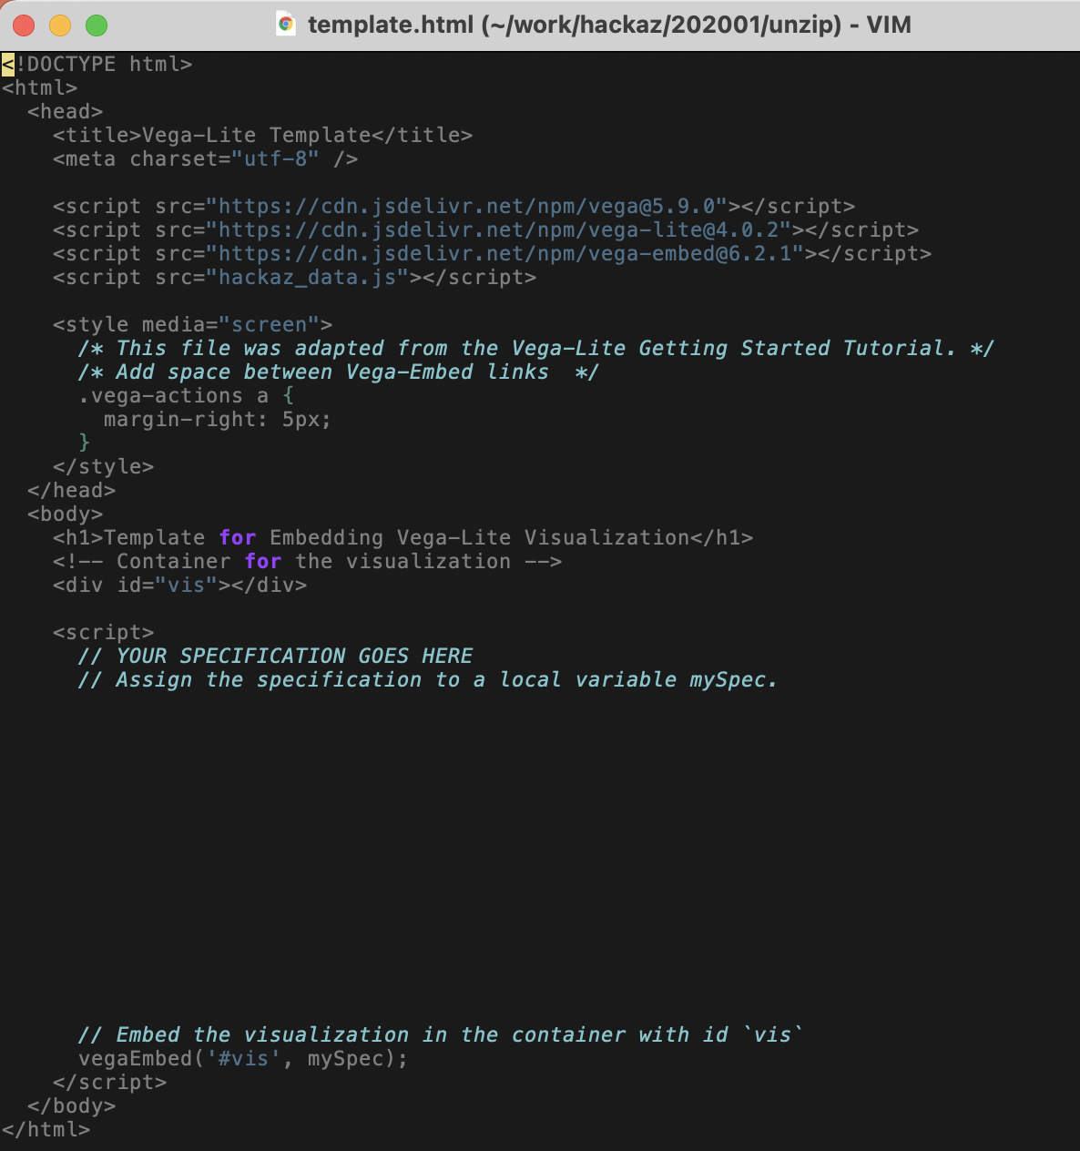
Open template.html in an editor too
Use whichever text editor you like as long as it will show you code.

Slide 27
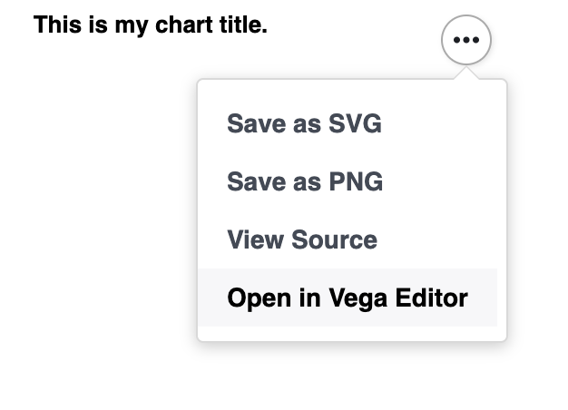
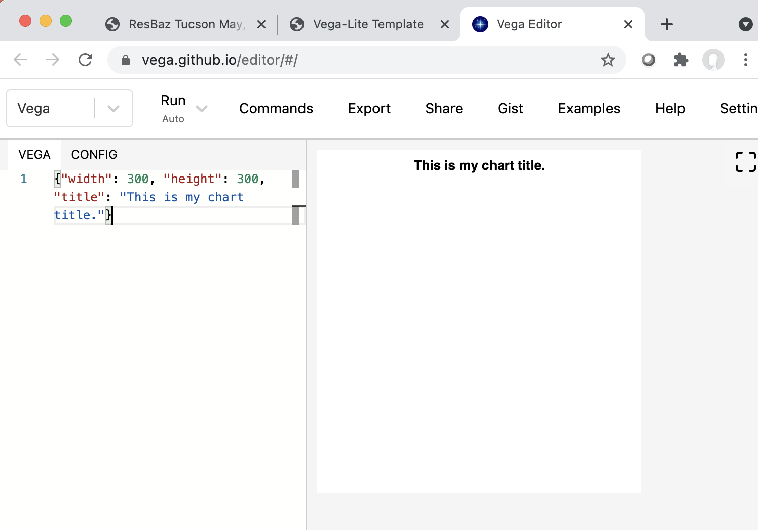
There’s also a Vega-Lite editor
You may have to copy and paste data to use this. We’ll see when we add data.

Slide 28
Vega-Lite can be embedded in a webpage
<!DOCTYPE html>
<html>
<head>…</head>
<body>
<div id=“vis”></div>
<script>
var spec = { …JSON specification here… };
vegaEmbed(’#vis’, spec);
</script>
</body>
</html>
Don’t worry about the red parts... Think of them as a template.

Slide 29
General JSON Syntax: Lists
JSON has two structures, an unordered object {} of key-value pairs and an ordered list [] of items, both are comma separated
List Example
[
"zero",
"one",
"two",
"three",
"four"
]
commas
No comma

Slide 30
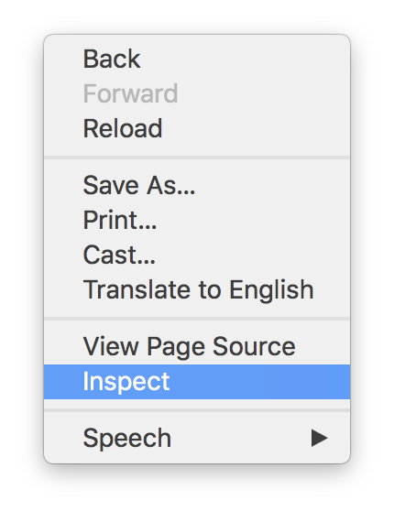
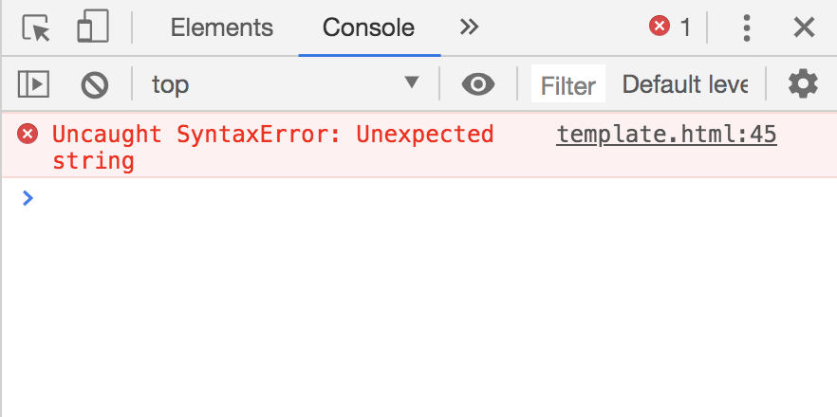
Missing commas often lead to strange error messages

Slide 31
General JSON Syntax: Objects
JSON has two structures, an unordered object {} of key-value pairs and an ordered list [] of items, both are comma separated
Object Example
{
"key1": 12.2,
"key2": "text here",
"key3": [1, 2, 3],
"key4": {"key1": 0.0 },
"key5": true
}
number
text (needs quotes)
list
another object
true or false

Slide 32
General JSON Syntax
JSON has two structures, an unordered object {} of key-value pairs and an ordered list [] of items, both are comma separated
Object Example
List of Objects Example
[
{ "id": 0,
"name": "foo"
},
{ "id": 1,
"name": "bar"
}
]
{
"key1": 12.2,
"key2": "text here",
"key3": [1, 2, 3],
"key4": { "key1": 0.0 },
"key5": true
}
comma

Slide 33
Anatomy of a Vega-Lite specification
{
"data": { "url": "dir/data.csv" },
"mark": "point",
"encoding": {
"x": {
"field": "column_name",
"type": "quantitative"
}
}
}
data
mark
encodings

Slide 34
Data can be a URL/file, variable name, or inline
"data": { "url": "data/mydata.json" }
"data": { "values": variable_name }
"data": {
"values": [
{ "id": 0, "foo": 7, "bar": "peas" },
{ "id": 1, "foo": 3, "bar": "carrots" },
{ "id": 2, "foo": 6, "bar": "carrots" },
{ "id": 3, "foo": 5.5, "bar": "peas" }
]
}

Slide 35
Several marks available
{
“mark”: "point",
}
area
bar
circle
line
point
rule
square
tick
rect
text
geoshape
boxplot
errorbar
errorband

Slide 36
Tooltips
From encodings:
{
"mark": { "type": "point", "tooltip": true }
}
From data:
{
"mark": { "type": "point",
"tooltip": { "content": "data" }
}
}

Slide 37
Small Example
var small = [
{ "weather": "sunny", "temp": 35 },
{ "weather": "sunny", "temp": 38 },
{ "weather": "sunny", "temp": 41 },
{ "weather": "partially sunny", "temp": 29 },
{ "weather": "partially sunny", "temp": 34 },
{ "weather": "rainy", "temp": 30 },
];
This data is in resbaz_az.js

Slide 38
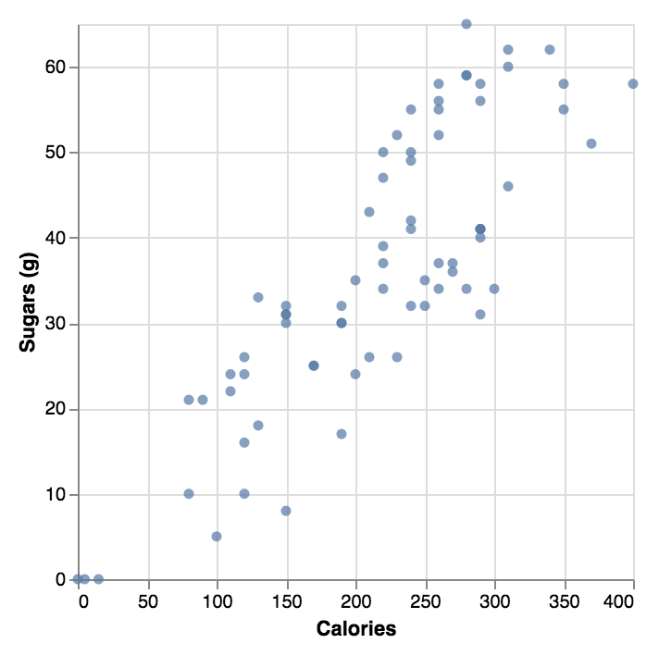
Exercise: Now that we’ve seen the small dataset, try a larger one
Replicate this plot with the Kaggle Starbucks nutritional information data. Don’t forget to add a tooltip!
"data": {
"values": drinks
}

Slide 39
Encoding: Mapping Data to Channels
x
y
x2
y2
xError
yError
xError2
yError2
color
opacity
fillOpacity
strokeOpacity
strokeWidth
size
shape
text
tooltip
href
…more…
Notes:
https://vega.github.io/vega-lite/docs/encoding.html

Slide 40
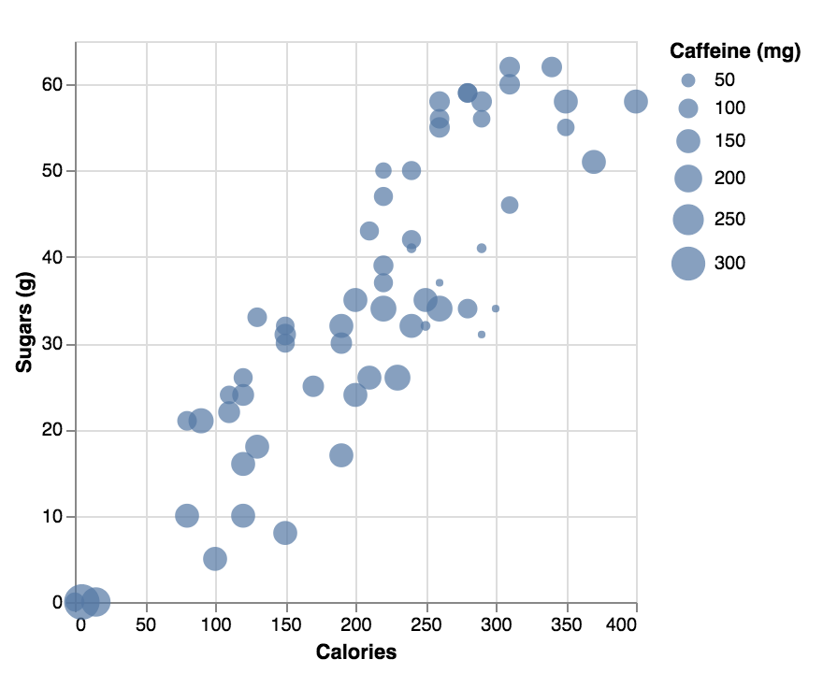
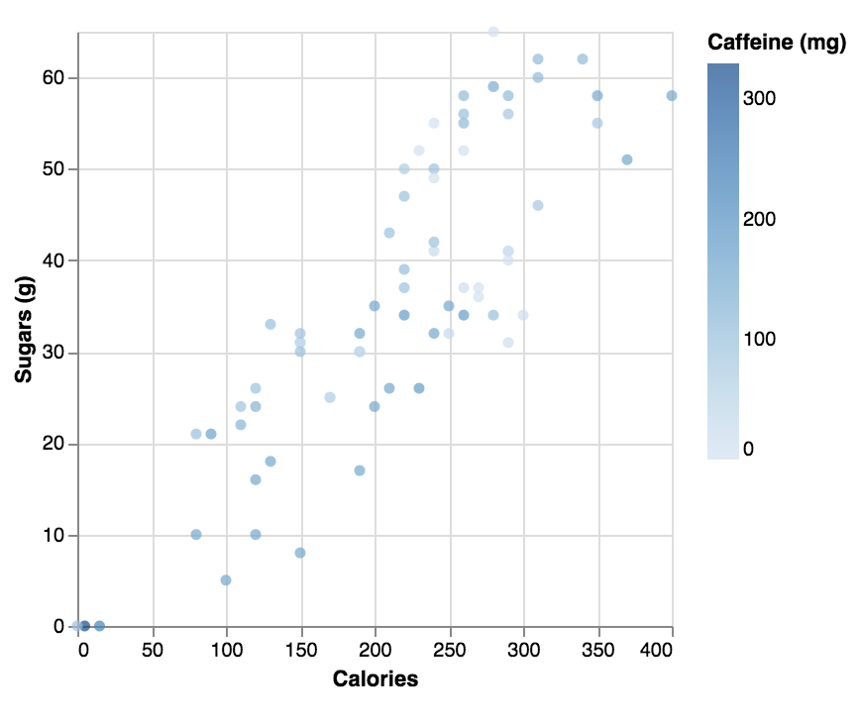
Exercise: Let’s encode Caffeine (mg) with size or color

Slide 41
Aggregation of Data
min
max
valid
missing
distinct
…more…
"encoding": {
"x": {
"field": "column_name",
"type": "quantitative",
"aggregate": "average"
}
}
count
sum
mean
average
median
variance
stdev
stderr
See also binning (histograms) and other transforms…
https://vega.github.io/vega-lite/docs/encoding.html
Notes:
https://vega.github.io/vega-lite/docs/encoding.html

Slide 42
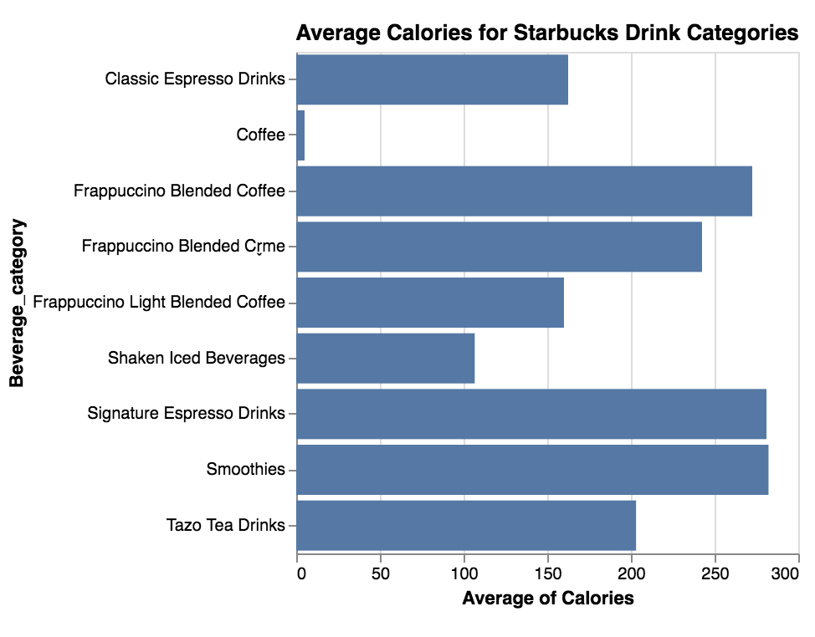
Exercise: Can you replicate the chart with the Starbucks Data?

Slide 43
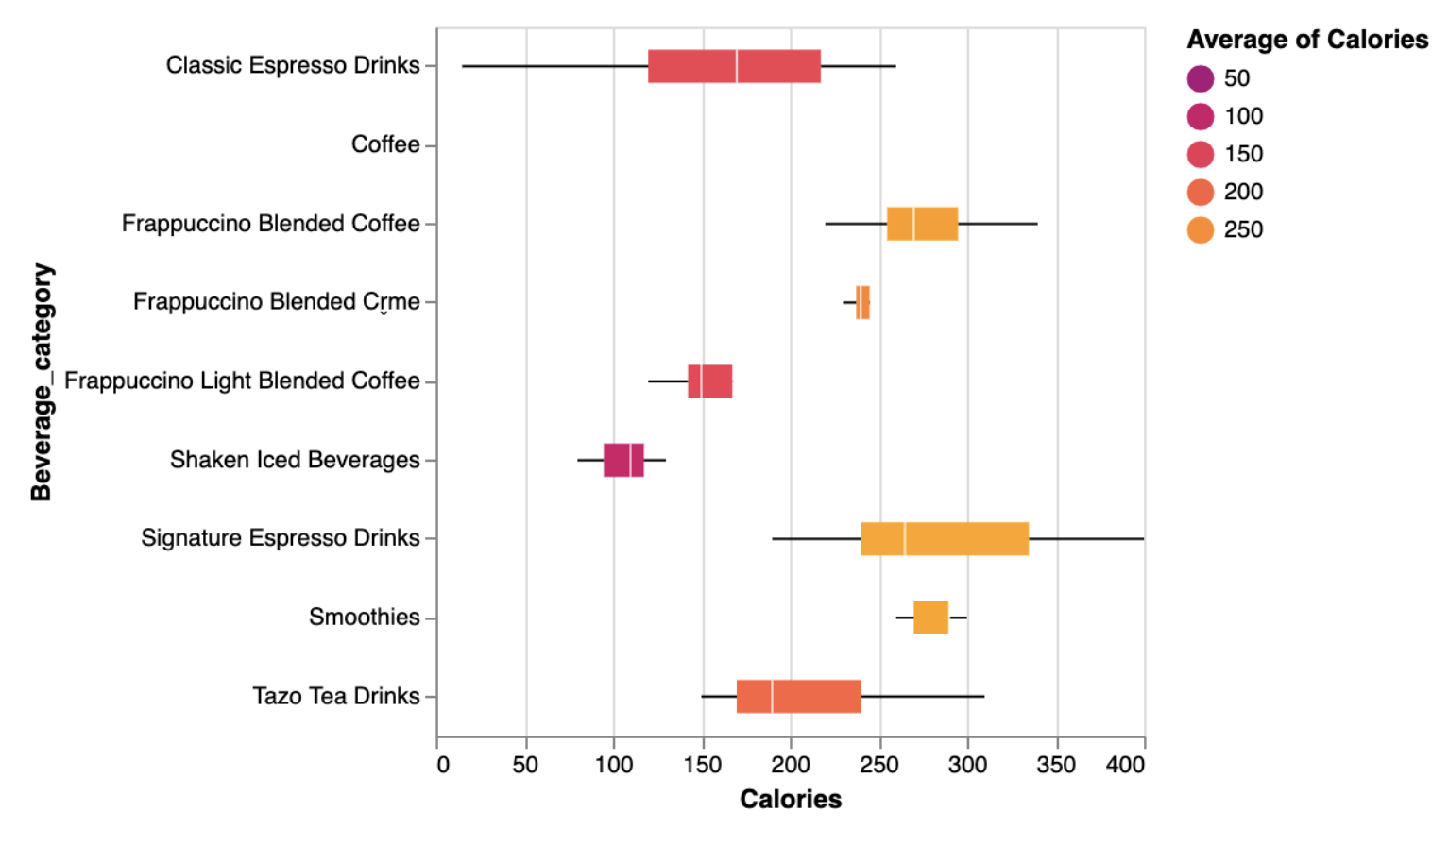
Exercise: Replicate this chart
You can specify details on the scale of an encoding with the scale parameter. Here’s a color example:
"color": {
"scale": {
"range": ["red", "blue"]
},
"field": "column_name",
”type": "quantitative"
}

Slide 44
Aggregation of Data - Histograms
min
max
valid
missing
distinct
…more…
"encoding": {
"x": {
"field": "column_name",
"type": "quantitative",
"bin": true
},
”y": {
"type": "quantitative",
"aggregate": ”count"
},
}
count
sum
mean
average
median
variance
stdev
stderr
Notes:
https://vega.github.io/vega-lite/docs/encoding.html

Slide 45

Exercise: Can you replicate this histogram with the Starbucks Data?

Slide 46
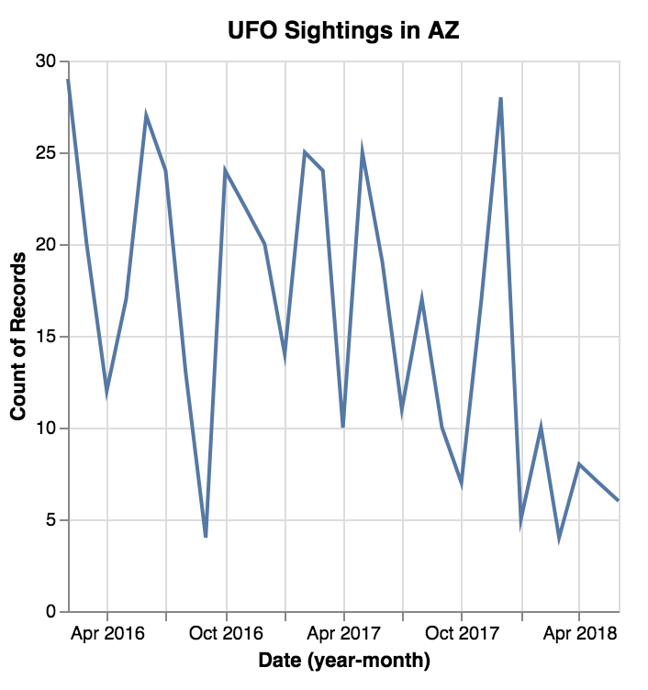
Temporal Data
We can set a timeUnit in the encoding to group data and then represent its aggregate:
"x": {
"field": "Date",
"timeUnit": "yearmonth",
"type": "temporal"
}
"y": {
"aggregate": "count",
"type": "quantative"
}

Slide 47
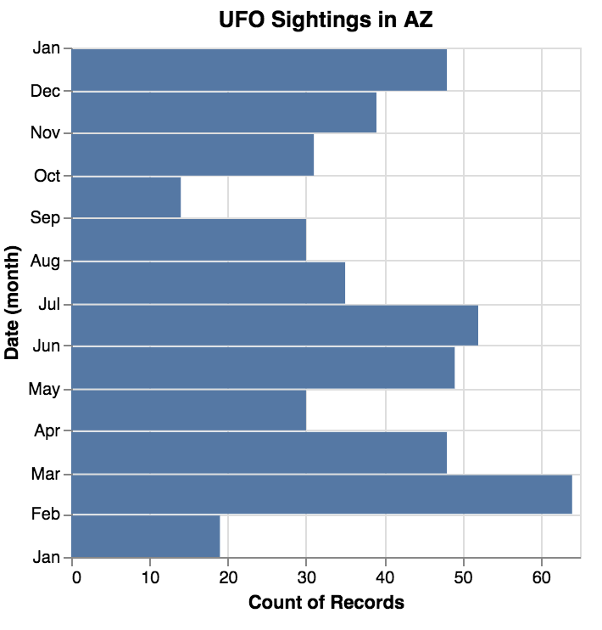
Exercise: Create this chart with the UFO Data
"data": {
"values" : ufos
}

Slide 48
Acknowledgements
This workshop is based on the tutorials and documentation at https://vega.github.io
Data Visualization basics are based on Visualization Analysis and Design, by Tamara Munzner
This workshop was funded by the National Science Foundation, under project NSF IIS-1844573

